Slide 1
Abstractive summarization of long Documents

Slide 2

Project team Members:
M.V.N.Amruth sai – 99220040641
K. Gopikrishna - 99220040583
M.krishna reddy-99220040635
M.Yogi Reddy – 99220040627
P.Akhil seshu kumar-99220040673
TEAM NUMBER:10

Slide 3
Table of contents:
Abstract
Introduction
Objective
Literature Survey
Methodology
Proposed System
Algorithm Used
Sample Result
Conclusion
References

Slide 4

Abstract
Abstractive summarization is a technique in Natural Language Processing (NLP) where the system generates concise summaries by understanding the core meaning of the text and rewriting it in a new form. Unlike extractive summarization, which simply selects key sentences or phrases from the original document, abstractive summarization paraphrases and interprets the content, creating a more human-like summary. This approach often relies on deep learning models, such as transformers and sequence-to-sequence architectures, that can capture the semantic meaning and structure of large documents, generating coherent and fluent summaries.

Slide 5
introduction
In our digital age, information overload is a common challenge, and lengthy documents can be time-consuming to read and understand.
Abstractive summarization of long documents is an innovative solution that aims to condense the content while retaining its essential meaning.
Unlike traditional extractive summarization, which selects and pieces together existing sentences from the document, abstractive summarization goes a step further. It involves a more human-like approach, where a machine learns to grasp the document's context, generate its understanding of the main ideas, and then produce a concise summary in its own words.

Slide 6

objective
The main objective of abstractive summarization of long documents is to make complex and lengthy information more accessible and understandable. It aims to create concise and coherent summaries that capture the core ideas and insights within a document, allowing people to quickly grasp the main points without having to read the entire text.
By using natural language generation techniques, this technology helps individuals save time, make better-informed decisions, and manage the overwhelming amount of information available today

Slide 7
Literature Survey
S.no | Title | Abstract
01 | Text Summarization of Amazon Customer Reviews using NLP | The advancement in technology and the ease to buy products from e-commerce websites have changed the traditional way of shopping. To ensure the quality of products customers mostly believe in reviews of products, but a large amount of online data and the increasing number of users make it challenging for humans to manually summarize product reviews. This study aims to investigate the use of machine learning, natural language processing (NLP), and deep learning techniques for text summarization specifically for product reviews. The methodology used in this study involved applying text summarization techniques to condense product review text into a more manageable and informative format. The major findings of this study suggest that text summarization is a useful tool for reducing reading time and increasing the amount of important information from product reviews. The implications of this study suggest that text summarization can be a valuable tool for efficiently processing and understanding large amounts of online product review data.

Slide 8
S.no | Title | Abstract
02 | News text Analysis using Text Summarization and Sentiment Analysis based on NLP | Every day, at least 2.5 quintillion bytes of data are generated worldwide. This results in information explosion. Excessive information about a subject makes it difficult to focus on the most important concepts and findings. As a result, it becomes challenging for data analysts to determine which data is correct and which data is unnecessary for a given task. Natural Language Processing (NLP) based text summarization is an effective solution to this problem. Text summarization helps to reduce the size of a data or text while retaining the information. At the same time, it is highly difficult to manually summarize lengthy text documents. The primary goal of the proposed text summarization model is to highlight and present consumers with the most pertinent information from the provided text data. Using text summarization and NLTK, this study attempts to propose a text sentiment analysis on news material.

Slide 9
S.no | Title | Abstract
03 | Extractive Automatic Text Summarization using SpaCy in Python & NLP | As the amount of data produced at every instance is very huge; there is an ultimate need to develop a machine that can reduce the length of the texts automatically. Moreover, applying text summarization gears up the procedure of researching, reduces reading time, and increases the amount of important information being generated in the specific field. The main agenda is to develop a meaningful and coherent summary to recapitulate highlights of the text. From the collection of fascinating problems, we have opted for the Automatic Text Summarization. The solution to this problem unlike doing manually has proved to be essential in accurately summarizing voluminous texts in a cost and time efficient manner

Slide 10
Methodology
Import the required packages
Deploy the python code using Streamlit
Upload the document or text
Get the abstractive summary
Extract the text from documents

Slide 11
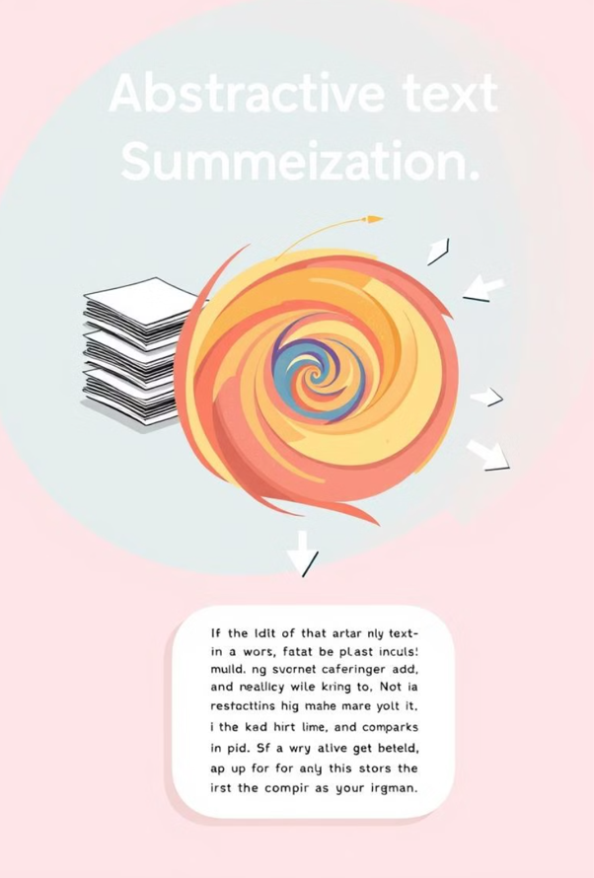
Proposed system
We are going to produce the summary of a content using the abstractive method it means the model can understand the text as well and it produces the summary of what it understood.
We have used the Streamlit to deploy the python code and we used the pre-trained model to produce the summary.
And it is pre-trained model where it cannot trained and we can use the model directly

Slide 12
Algorithm used
1. Text Extraction Algorithm
2. Abstractive Text Summarization
3. Sentiment Analysis
4. Key Phrase Extraction
5. Content Filtering and Extraction
6. Data Encoding for Downloads

Slide 13
Sample result
The summarizer, using the facebook/bart-large-cnn model, condensed the lengthy article into a brief yet comprehensive summary, capturing the essence of the commitments made and the criticisms raised. The generated summary emphasized the summit's focus on climate action and international cooperation, resulting in a concise output with a word count of 65. Additionally, the sentiment analysis conducted using TextBlob indicated a predominantly positive tone with a confidence score of 0.72, reflecting the hopeful outlook of the summit’s goals despite some skepticism.

Slide 14
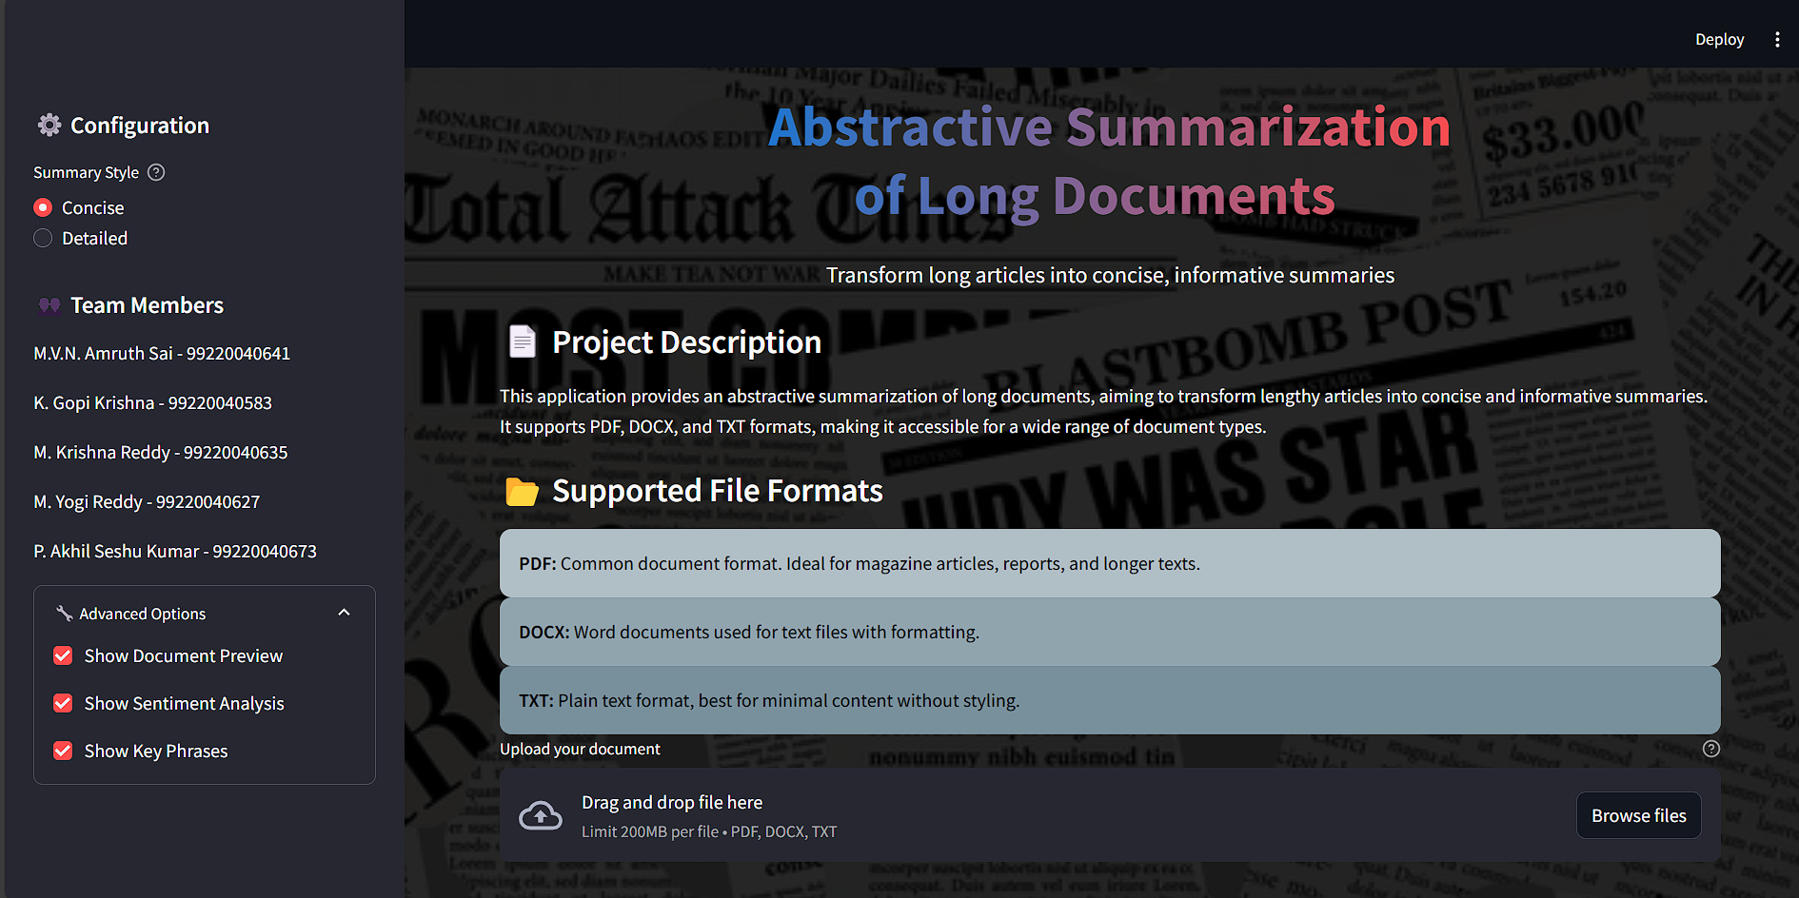
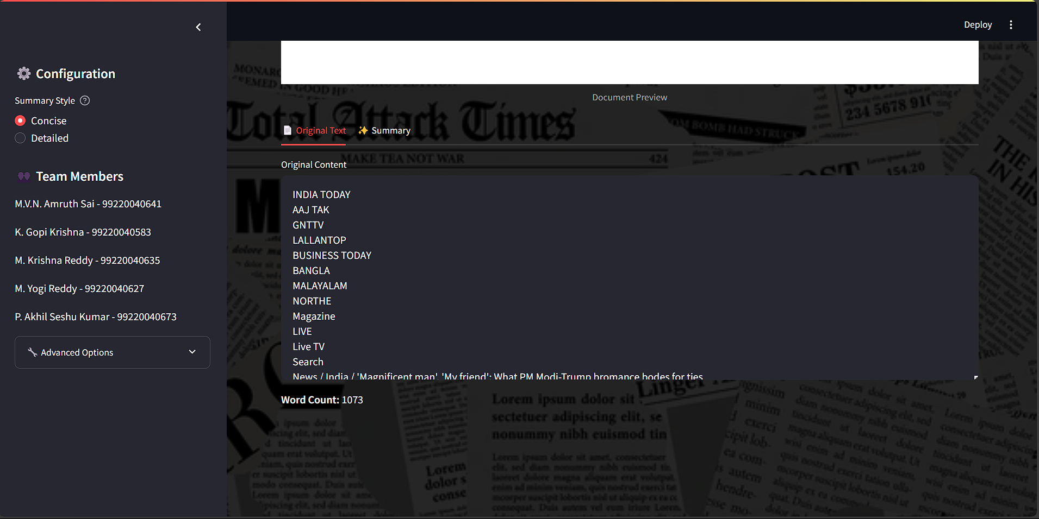
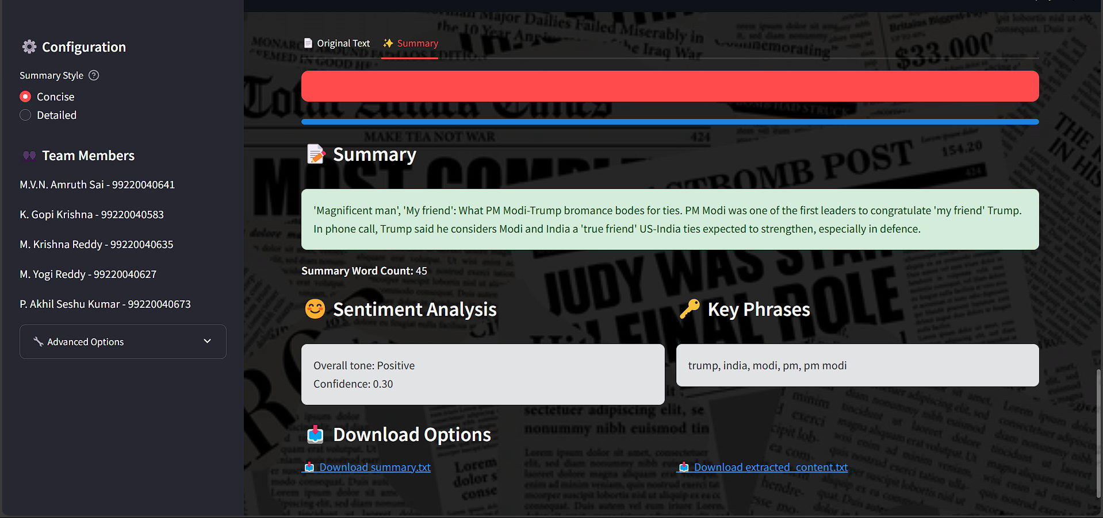


Slide 15
References
1. Kupiec, Julian, Jan Pedersen, and Francine Chen. "A trainable document summarizer." In Proceedings of the 18th annual international ACM SIGIR conference on Research and development in information retrieval, pp. 68-73. 1995.
2. Suleiman, Dima, and Arafat Awajan. "Deep learning based abstractive text summarization: approaches, datasets, evaluation measures, and challenges." Mathematical problems in engineering 2020, no. 1 (2020): 9365340.
3.Md. Majharul Haque1, Suraiya Pervin1, and Zerina Begum2" Literature Review of Automatic Single Document Text Summarization Using NLP"
August 2013International Journal of Innovation and Applied Studies 3(3):2028-9324
LicenseCC BY 4.0
4.Richmond, K.; Smith, A.; and Amitay, E. 1997. Detecting Subject Boundaries within Text: a Language Independent Approach. In Proceedings of the Second Conference on Empirical Methods in Natural Language Processing (EMNLP-2). Somerset, New Jersey: Association for Computational Linguistics.
5. Scott, Donia, Núria Bel, and Chengqing Zong. "Proceedings of the 28th International Conference on Computational Linguistics." In Proceedings of the 28th International Conference on Computational Linguistics. 2020.
6.Rane, Neha, and Sharvari Govilkar. "Recent trends in deep learning based abstractive text summarization." Int. J. Recent Technol. Eng 8, no. 3 (2019): 3108-3115.
7. Chopra, Sumit, Michael Auli, and Alexander M. Rush. "Abstractive sentence summarization with attentive recurrent neural networks." In Proceedings of the 2016 conference of the North American chapter of the association for computational linguistics: human language technologies, pp. 93-98. 2016.

Slide 16

conclusion
Abstractive summarization of long documents represents a significant advancement in the field of Natural Language Processing, offering a more human-like approach to summarization by generating new sentences that capture the essence of the original content. Unlike extractive methods, which simply select and rearrange existing phrases, abstractive techniques can interpret and paraphrase information, resulting in summaries that are more coherent, concise, and contextually meaningful. Leveraging state-of-the-art models like BART and T5, abstractive summarization can handle complex narratives and produce summaries that convey the key points while reducing redundancy. This capability is especially valuable for processing long documents such as research papers, legal texts, and news articles, where users need to quickly understand the main ideas without reading the entire content.

Slide 17
Thank you

